Slide 1

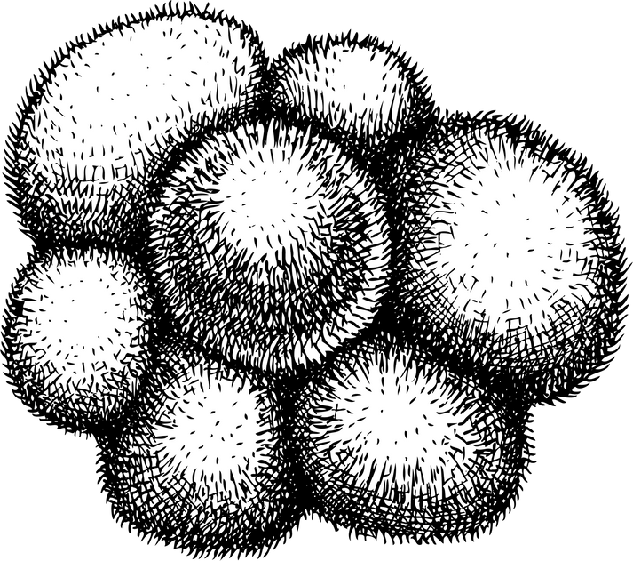
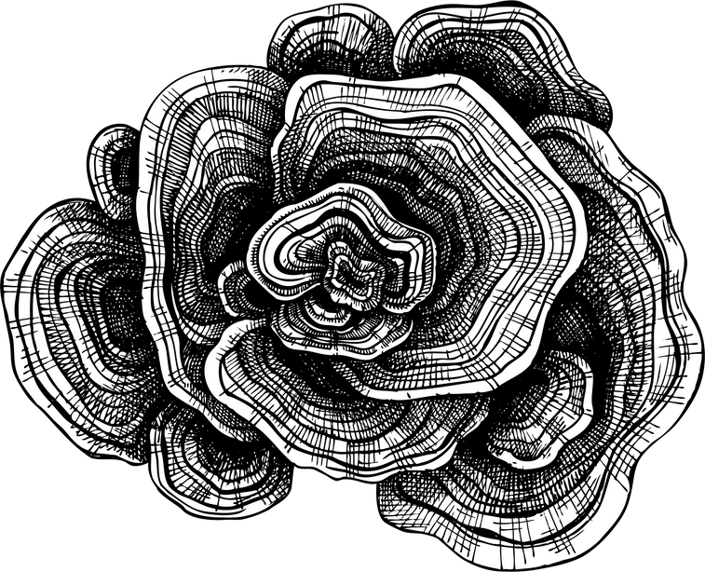
TREE BIOGRAPHIES

Slide 2
ELVIA WILK
‘The word landscape is typically used to suggest the passive, the inert, the natural - the plant, animal, and mineral world that constitutes a backdrop for a human actor. But here; the sudden absence of a human actor occasions a sudden presence: the presence of landscape, the presence of plants.’

Slide 3
GENRES OF ECOFICTION
ECOHORROR
SOLARPUNK
LUNARPUNK
CLIMATE FICTION / CLIFI
HOPEPUNK
WHAT DO THEY HAVE IN COMMON?

Slide 4

THE NATURAL WORLD AS...
DARK
MODIFIED
MYSTERIOUS
Is this reality or projection?
What is a projection of?
ENGINEERED
EVIL
DIRTY
BACKGROUND
HUNGRY
UNKNOWABLE

Slide 5
NON-HUMAN BIOGRAPHIES
We are constantly thinking from an anthropocentric point of view. We project our culture, our biases, our values, & our beliefs. To write a non-human biography is to let go and embody another way of living and seeing. Question all of your assumptions, tap into your childlike wonder, and see where it leads you.

Slide 6
IS THERE A DIFFERENCE BETWEEN HUMAN CENTERED, HUMAN / NON-HUMAN ENTANGLEMENTS, & NON-HUMAN CENTERED NARRATIVES?

Slide 7
SOPHIE STRAND
'If you pray, ask yourself: Does your prayer have roots? Does your god sometimes grow fur? Do your holy words sprout leaves?'

Slide 8
WRITING THE BIOGRAPHY
You can do this in a variety of ways, but I suggest mindmapping your questions about trees first. For example, do trees speak? If so, how would they do it?
After you feel you have enough questions, choose one or two, and figure out what voice you want to you use before freewriting. Are trees singular? Are they plural? Do they speak with one voice or many? Write from their point of view.

Slide 9
QUESTIONS
Is there such a thing as Low or High Oak?
Do you trees speak in slang?

Slide 10
QUESTIONS
How does health or illness play a factor in their multispecies interactions? What about disability?
What part does witnessing have to play in deforestation?

Slide 11
QUESTIONS
What do they leave behind? What do they inherit? Is it a multispecies inheritance?
Is there such a thing as Antideluvian culture or language? How do the trees remember this time?

Slide 12
To dream of other ways of being and knowing, to embody the non-human, is to take a step into the ecosystemic body or the second self, that is influenced by the ecologies beyond what we normally consider ‘us’. It is a practice to break apart dualisms from self and other to subject and object. It’s to recognize that we are all permeable, we are all subjects with lives to live, and all our lives are have intrinsic worth. We are more alike that we know, and more different than we can imagine.
CONCLUSION

Slide 13
THEODORE ROSZAK
“The person is anchored within a greater, universal identity.
Salt remnants of ancient oceans flow through our veins,
ashes of expired stars rekindle in our genetic chemistry.”

Slide 14
THANK YOU

Slide 15
SUGGESTED READS
  The Author of the Acacia Seeds and Other Extracts from the Journal of the Association of Therolinguistics by Ursula K. Le Guin
  Death By Landscape by Elvia Wilk
  Writing the Animal Other: Beyond Anthropomorphism by Heather Durham

Slide 16
SUGGESTED READS
  The Descriptive Turn in German Nature-Oriented Neue Sachlichkeit (1913–1933) An Essay on Nonhuman Literary Genres By Michael Karlsson Pedersen
  Nature’s Aliveness: Ecopsychology, Embodiment and the Expressive Arts by Sophia Reinders

